Slide 1


2023 Hyland Hackathon
WELCOME
tinyurl.com/
hackhyland2023
Wi-Fi Network: Hackathon
Password: HylandSoftware!

Slide 2
tinyurl.com/ hackhyland2023
Everything you need to know for the Hackathon, all in one place!

Slide 3
🛣️
Pathways
Make the most of your Hackathon experience
FOLLOW

Slide 4
Choose a Track
Explorer
Artisan
Scientist
🚀
🖌
🧪
For students who are just beginning their voyage into the world of software development
For students with some programming experience who are interested in the creative aspects of development
For students who love the technical details of projects and have significant programming experience

Slide 5
Workshops & Sessions
Hacky Hour
UX
Intro to Git
Building a Website
OpenAI
Programming Synthwave
🎈
🤳
🍴
Friday, 5-6PM ET
Friday, 6:30-7:15PM ET
Friday, 8-9:30PM ET
🕸
🤖
🎹
Friday, 8-9:30PM ET
Saturday, 3-3:30PM ET
Saturday, 6:45-7:30PM ET
Full activity schedule available at tinyurl.com/hackhyland2023

Slide 6
Important Times
Friday 5pm ET
Sunday 1pm ET
Sunday 4pm ET
Teams Due
Entry Round Deadline
Final Round
Assemble your team
and submit your members
Submit your project for the Entry Round of the competition
Advancing teams will present live in front of the judges

Slide 7

Discord Communication
Discord is a free communication app that lets you share voice, video, and text chat with friends, game communities, and developers.
For this Hackathon, Discord is not required - just highly recommended ☺
Main Channels
announcements: watch for important updates
general: chat with everyone else at the Hackathon
questions: ask event & development questions
More Categories
Division Channels: grade levels, tracks, and locations
Off Topic Channels: fun times
Team Channels: ask us if you need a channel!
More information at tinyurl.com/hackhyland2023

Slide 8
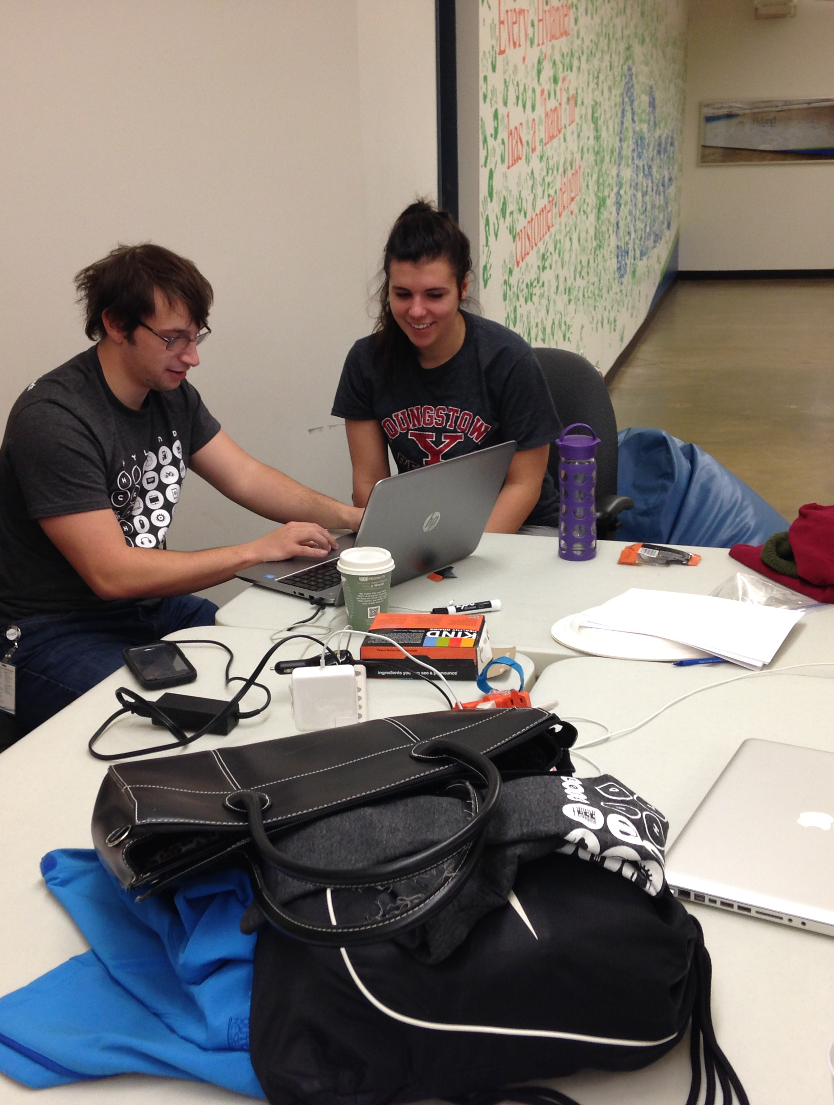
Mentors
Technology pros available to assist you!
Virtual: @mentors on Discord, or Zoom
In-Person: Mentor Room
No 1:1 interactions are permitted
More information at tinyurl.com/hackhyland2023

Slide 9
📏
Guidelines
PROSPERITY
Follow these rules to ensure your success

Slide 10
Code of Conduct
We value the participation of each member of the student community and want all participants to have an enjoyable and fulfilling experience. Accordingly, all participants are expected to show respect and courtesy to all other participants throughout the hybrid hackathon.
Participants asked to stop any harassing behavior are expected to comply immediately. If participants fail to comply, they will be asked to leave the event.
If a participant engages in behavior that violates this code of conduct, the hackathon organizers will take any action they deem appropriate.

Slide 11
Competiton Rules
Fresh Code
Ownership
Teams are limited to 5 members
Only work created during the Hackathon is allowed to be included in your submission
Teams have full ownership of projects created during the Hackathon

Slide 12
Judging Process
📺 Entry Round
Create a video submission for the first round of the competition
Videos should be 2-3 minutes
Resources are available to help you record your presentation
The deadline to submit a video is Sunday at 1pm ET
🏆 Final Round
The top teams from each grade level will present live in front of judges
Presentations should be under 5 minutes
Judges will have time to ask questions
After all presentations, judges will select the first and second place winners from each grade level!

Slide 13
Judging Criteria
Innovation
User Interface
Quality
Impact
💡
📱
Is your project new and cutting-edge?
Is your product
user-friendly?
📈
🤍
Does your code work as intended?
Does your solution make a positive difference?

Slide 14
🏆
Prizes
2023 Hyland Hackathon

Slide 15
Giveaway Prizes
Earn Tickets throughout the weekend by attending activities, helping others, asking great questions, and participating.
Each ticket you earn will give you one more chance to win!

Slide 16
Physical Prizes
🍭
Candy Bag
💧
Water Bottle
🦆
Rubber Ducks
👜
Grab Bag
🧸
Stuffed Animal
Yum!
Ahh!
Quack!
Assorted!
Cute!
IN-PERSON
Notes:
Candy – assorted candy bags
Rubber Ducks - https://www.amazon.com/SmartYeen-Toddlers-Assorted-bathtime-Birthday/dp/B0B4CDBDS9/
Stuffed animals - https://www.amazon.com/TeeTurtle-Reversible-Octopus-Mini-Plush/dp/B07H4HKDG7, https://www.amazon.com/dp/B09ZXTGRMY/, https://www.amazon.com/Aurora-World-Rolly-Prankster-Plush/dp/B01MZFBOVV/, https://www.amazon.com/Aurora-World-31290-Foxxie-Plush/dp/B004JRR5BM/, https://www.amazon.com/Melissa-Doug-Stuffed-Washable-Surface/dp/B004N7NFSK/
Squishmallow - https://www.amazon.com/dp/B09NB3QP1P/, https://www.amazon.com/dp/B09NB1QQWC/, https://www.amazon.com/Squishmallow-Official-Kellytoy-Ultrasoft-Stuffed/dp/B08G1W7G93
Water Bottle – hyland branded
Grab bag – USB sticks, extra swag, sunglasses

Slide 17
Digital Prizes
🎧
Audible Credit*
🎹
Bonus Track
🖼
A.I. Portraits
🖋
A.I. Poetry
🏫
Udemy Course*
Literary!
Musical!
Artistic!
Iambic!
Educational!
VIRTUAL
*international prize options may vary
Notes:
Audible credit - https://www.audible.com/ep/giftcenter
A.I. Portraits – Matt can generate through DALL-E
A.I. Poetry – Matt can generate through GPT-3
Bonus Track – Joseph can create a custom synthwave track
Udemy Course - https://support.udemy.com/hc/en-us/articles/229231187-How-to-Send-a-Udemy-Gift-
(note for udemy courses – the prices might go way up, so we should have a backup plan)

Slide 18

Grand Prizes
The judges will select the top two teams from each level. Each member will win one of these valuable prizes…

Slide 19

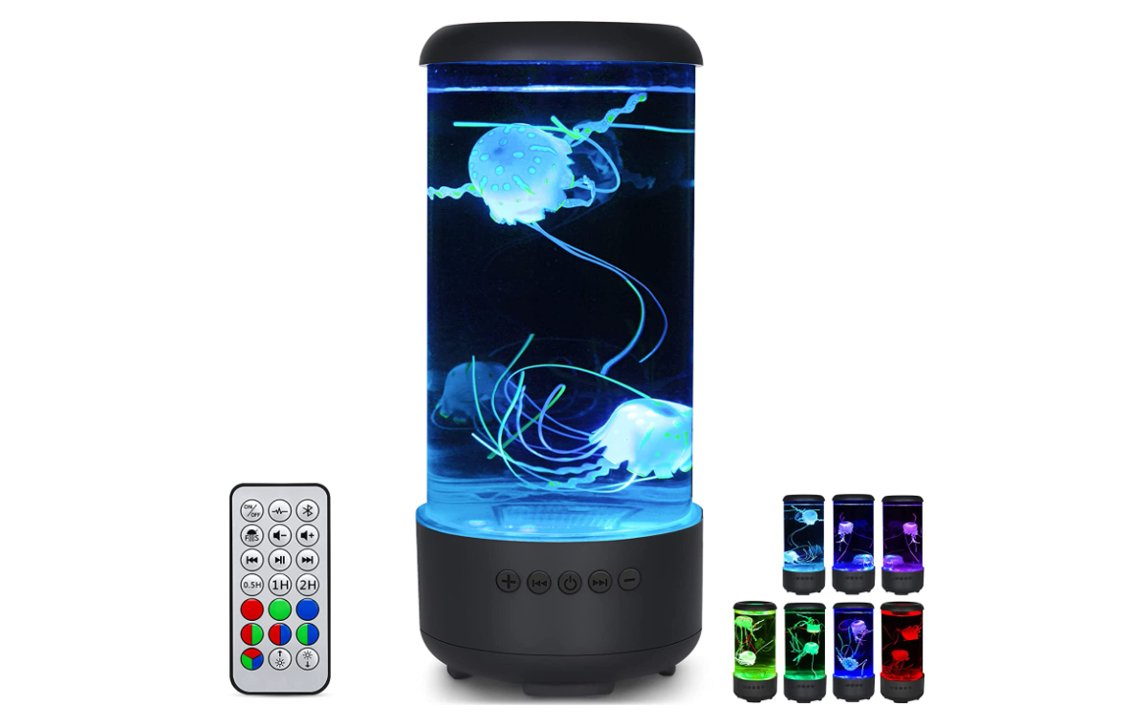
Second Place: Pick One
Pixel Art Bluetooth Speaker*
LED Jellyfish Lamp*
*international prize options may vary
Notes:
LED lamp: https://www.amazon.com/dp/B0B8R4T5HX/
Pixel Art Speaker: https://www.amazon.com/dp/B0811XB8VB/ref=cm_gf_acbr_iaac_d_p0_e0_qd0_NUOdAM3fFvGTmlUdfhxg

Slide 20
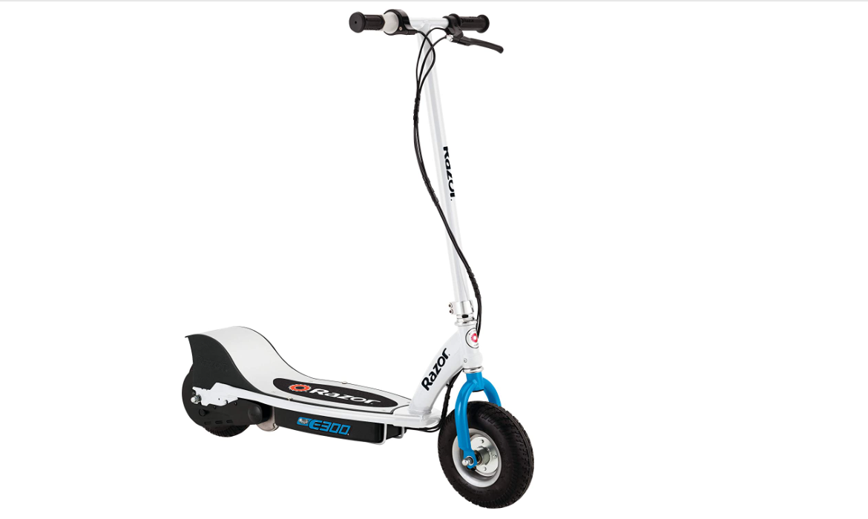
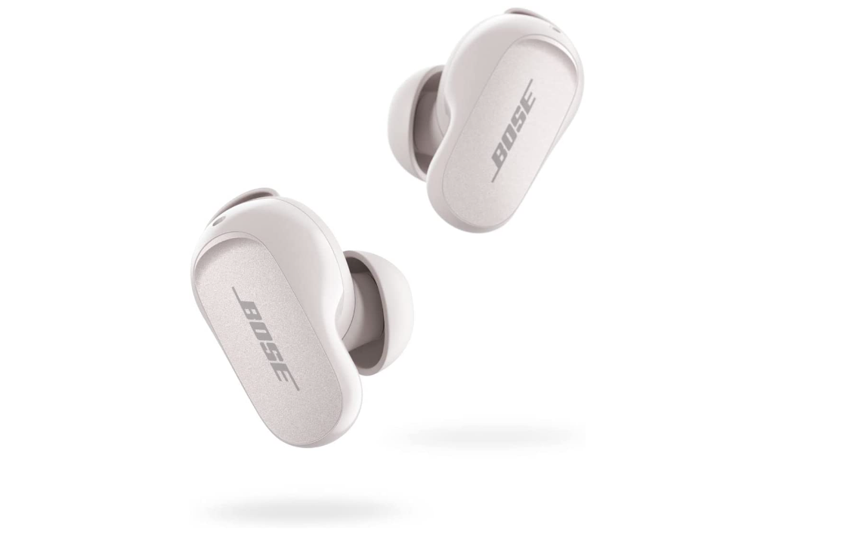
First Place: Pick One
Electric Scooter*
Bose Noise Cancelling Earbuds*
*international prize options may vary
Notes:
Bose Earbuds: https://www.amazon.com/dp/B0B7838HH6/
Electric Scooter: https://www.amazon.com/Razor-E300-Electric-Scooter-White/dp/B083G8KWCY

Slide 21
Good Luck!
Questions?
Virtual participants are free to go!

Slide 22
🏢
In-Person Info
Thank you for joining us at Hyland’s Headquarters

Slide 23
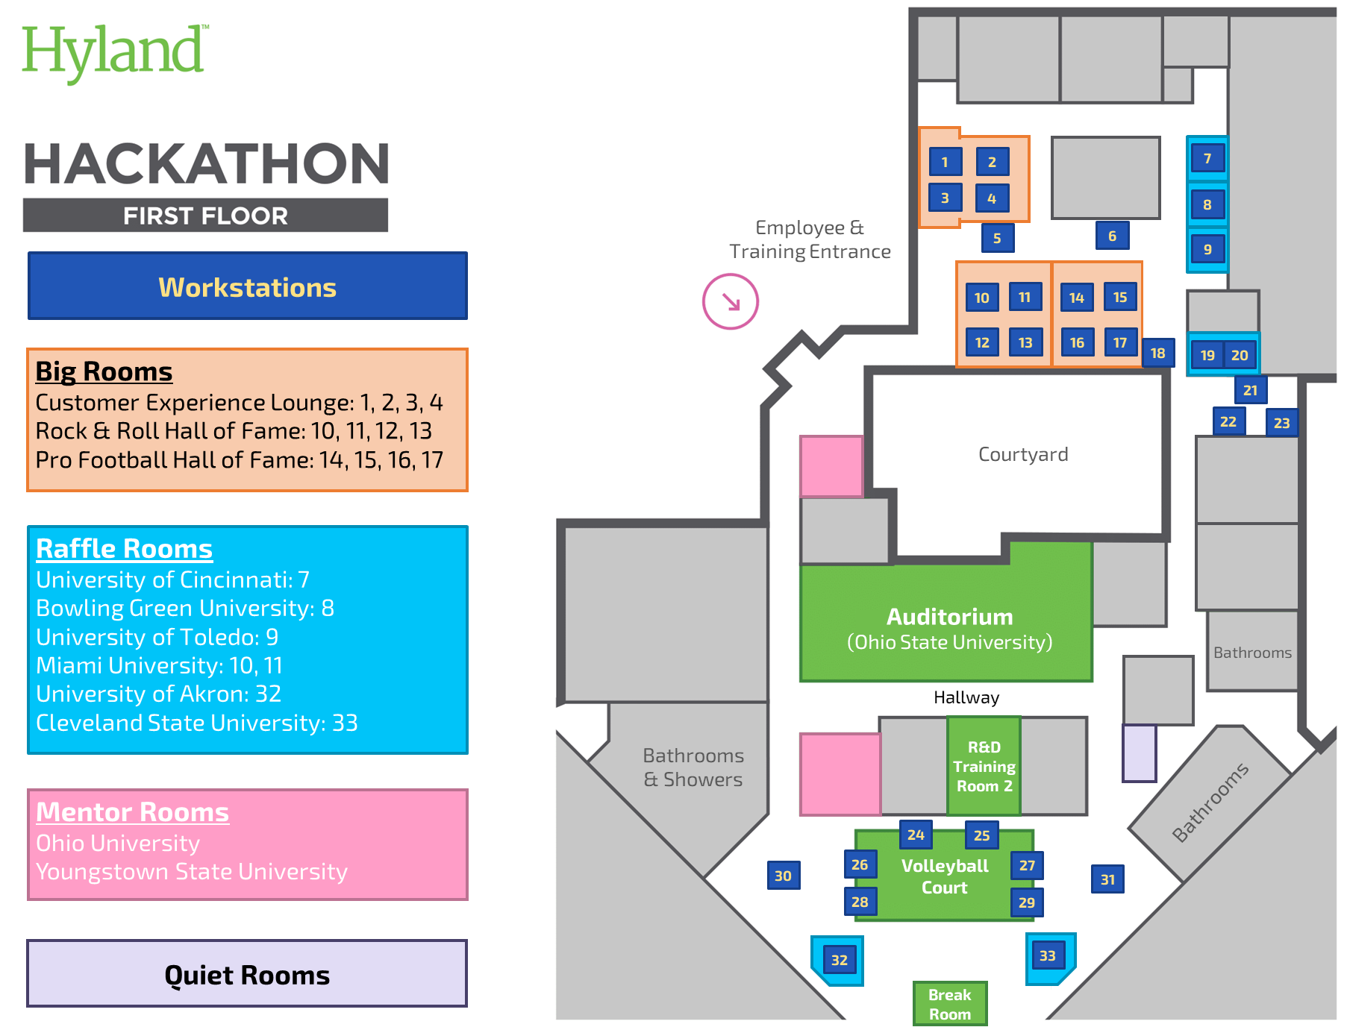
Workstation Map
Also available at tinyurl.com/
hackhyland2023
Note: Couches are first come, first serve!

Slide 24

Contact
Emergency
Facilitators
Discord
🆘
Call: 911
Desk Phone: 9-911
Marissa: (216) 314-7660
Joseph: (216) 218-2609
Caitlin: (216) 469-4921
Visit the Mentor Room
Reach mentors and event facilitators online
More information at tinyurl.com/hackhyland2023

Slide 25

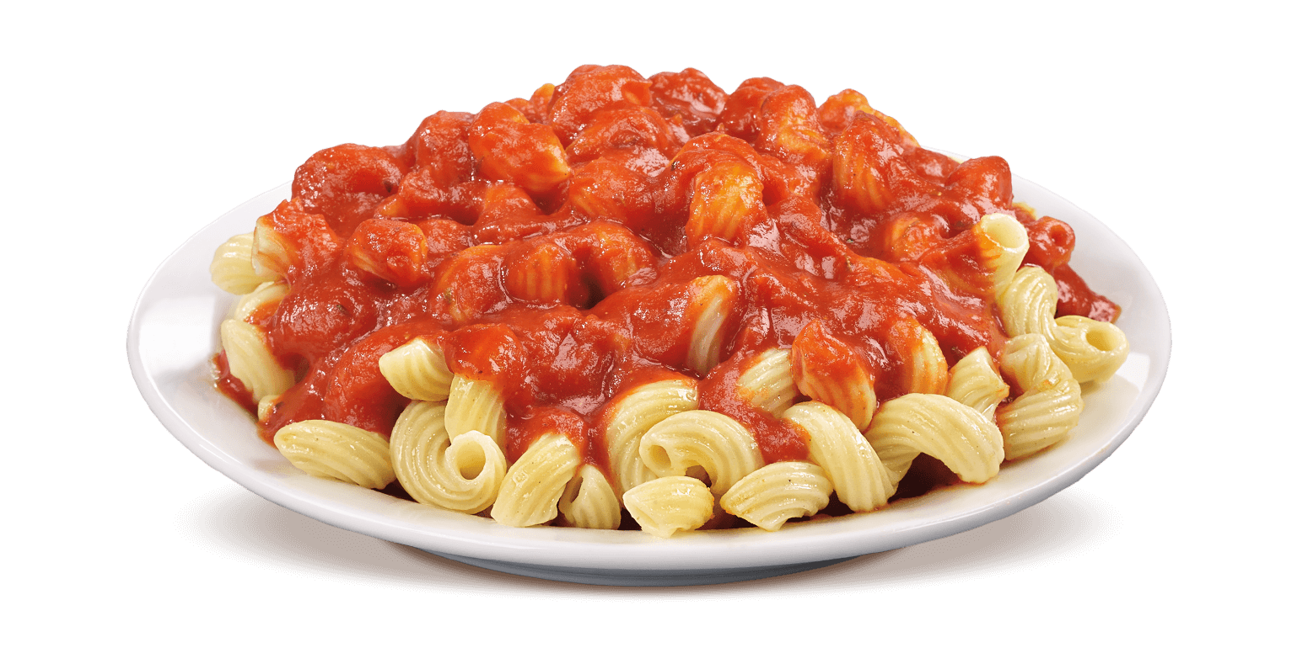
Food & Beverages
Saturday Lunch
Giant Eagle Sandwiches
Saturday Dinner
Giant Eagle Chicken Tenders & Mac n Cheese
Sunday Lunch
Jimmy John’s Sandwiches
Saturday Dinner
Giant Eagle Pasta

Slide 26
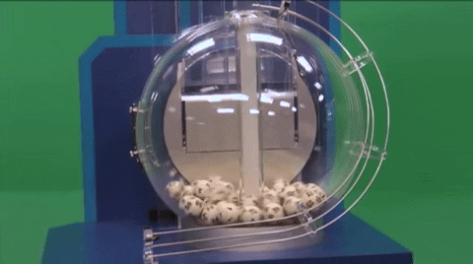
Room Lottery

Slide 27
Workstation Map
You
Are
Here!
Also available at tinyurl.com/
hackhyland2023

Slide 28
Questions?
THANK YOU

